Slide 1


ES Counselor Meeting
January 16, 2025

Slide 2


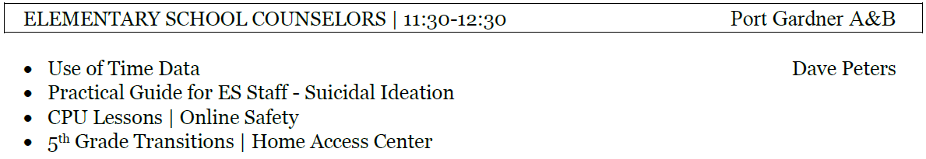
Today’s Agenda

Slide 3
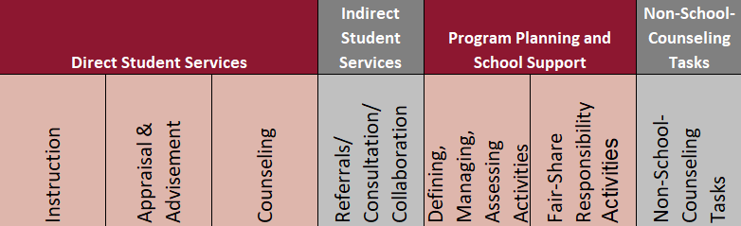
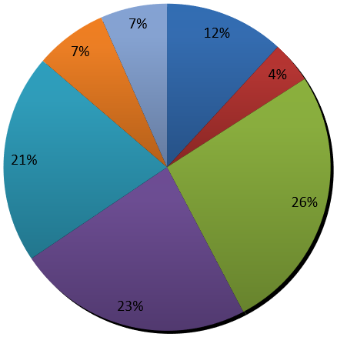
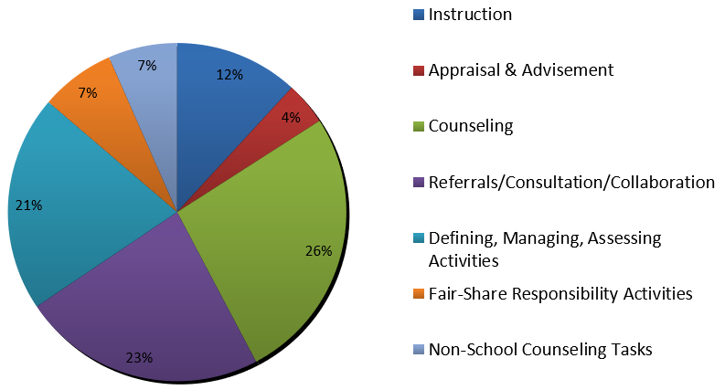
CSCP | Use of Time Calculator Results

Slide 4
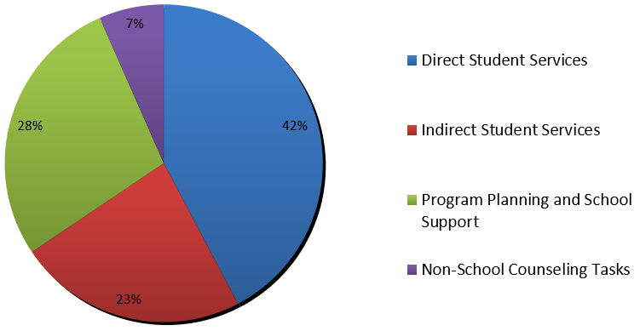
CSCP | Use of Time Calculator Results

Slide 5

Practical Guide for ES Staff

Slide 6

Practical Guide for ES Staff

Slide 7


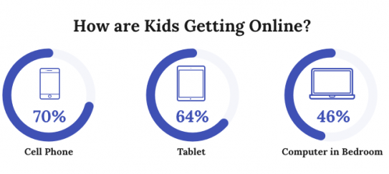

CPU Lessons | Online Safety
Online Safety Lessons K-2.pdf

Slide 8

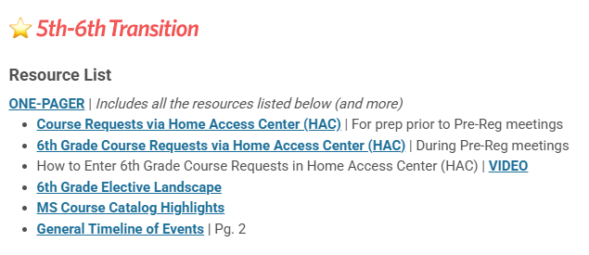
5th Grade Transitions
Updated resources coming soon for 2025-26!

Slide 9


Best wishes for a smooth semester transition!

